Slide 1

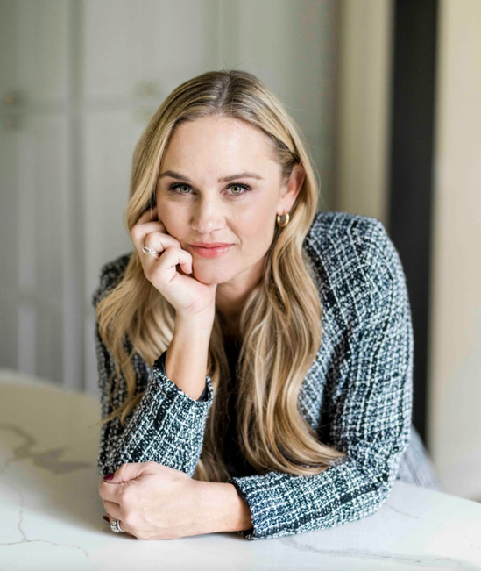
KELSTON MARKETING
USABILITY TESTING IN ACTION
By: Robert Warren
Full Sail Digital Marketing M.S.
Digital Design and Usability
Professor: Vidal Fonseca
Disclaimer: This presentation is a component of my Master of Science program at Full Sail University. This graduate program culminates with a comprehensive Digital Marketing plan for a student-selected case study organization. While my coursework utilizes a real organization, it is not directly reflective of or approved by them.
Stephanie Cross, Kelstons Founder
(Kelston Marketing, n.d.)

Slide 2
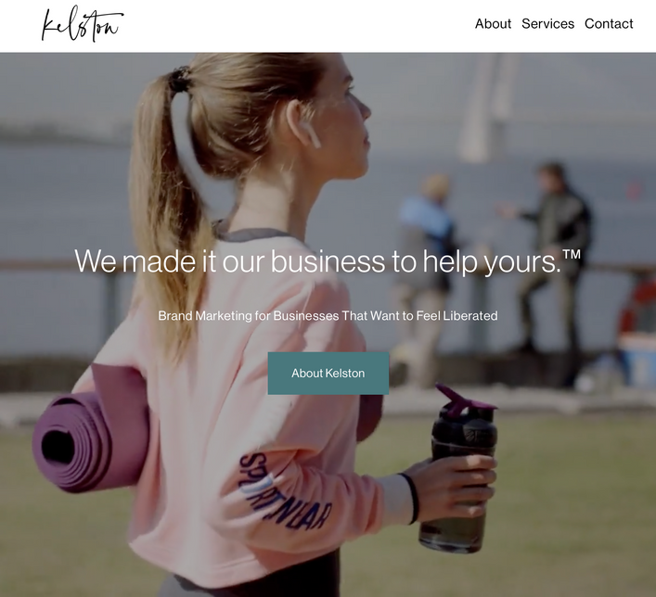
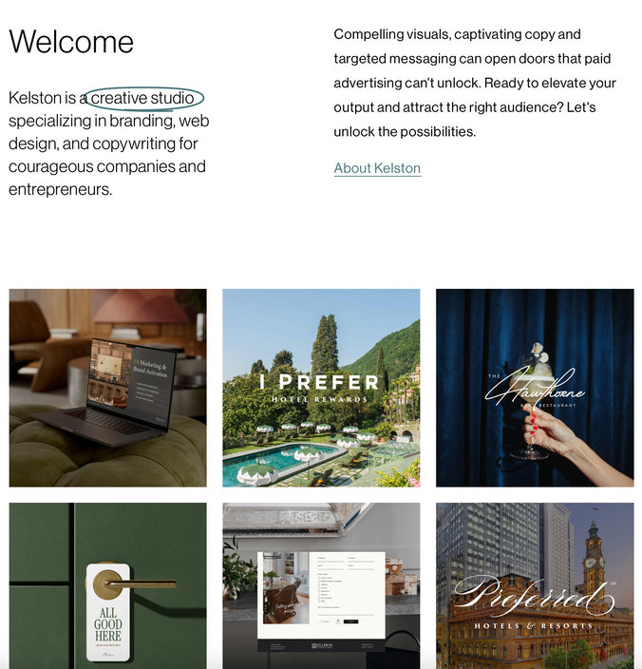
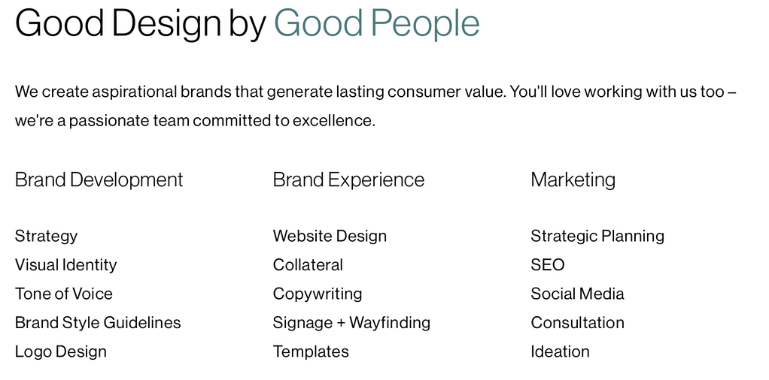
INTRODUCTION
Kelston Marketing is a marketing agency in Southlake, Texas serving national clients in organic marketing and branding strategies. The target market is both entrepreneurs and businesses.
  The websites purpose is to connect both businesses and entrepreneurs with Kelston
  After visiting the site viewers should: understand the services, have a understanding of the company, know how to get in touch, and have a desire to either come back, or learn more.
(Kelston Marketing, n.d.)
(Kelston Marketing, n.d.)
(Kelston Marketing, n.d.)

Slide 3
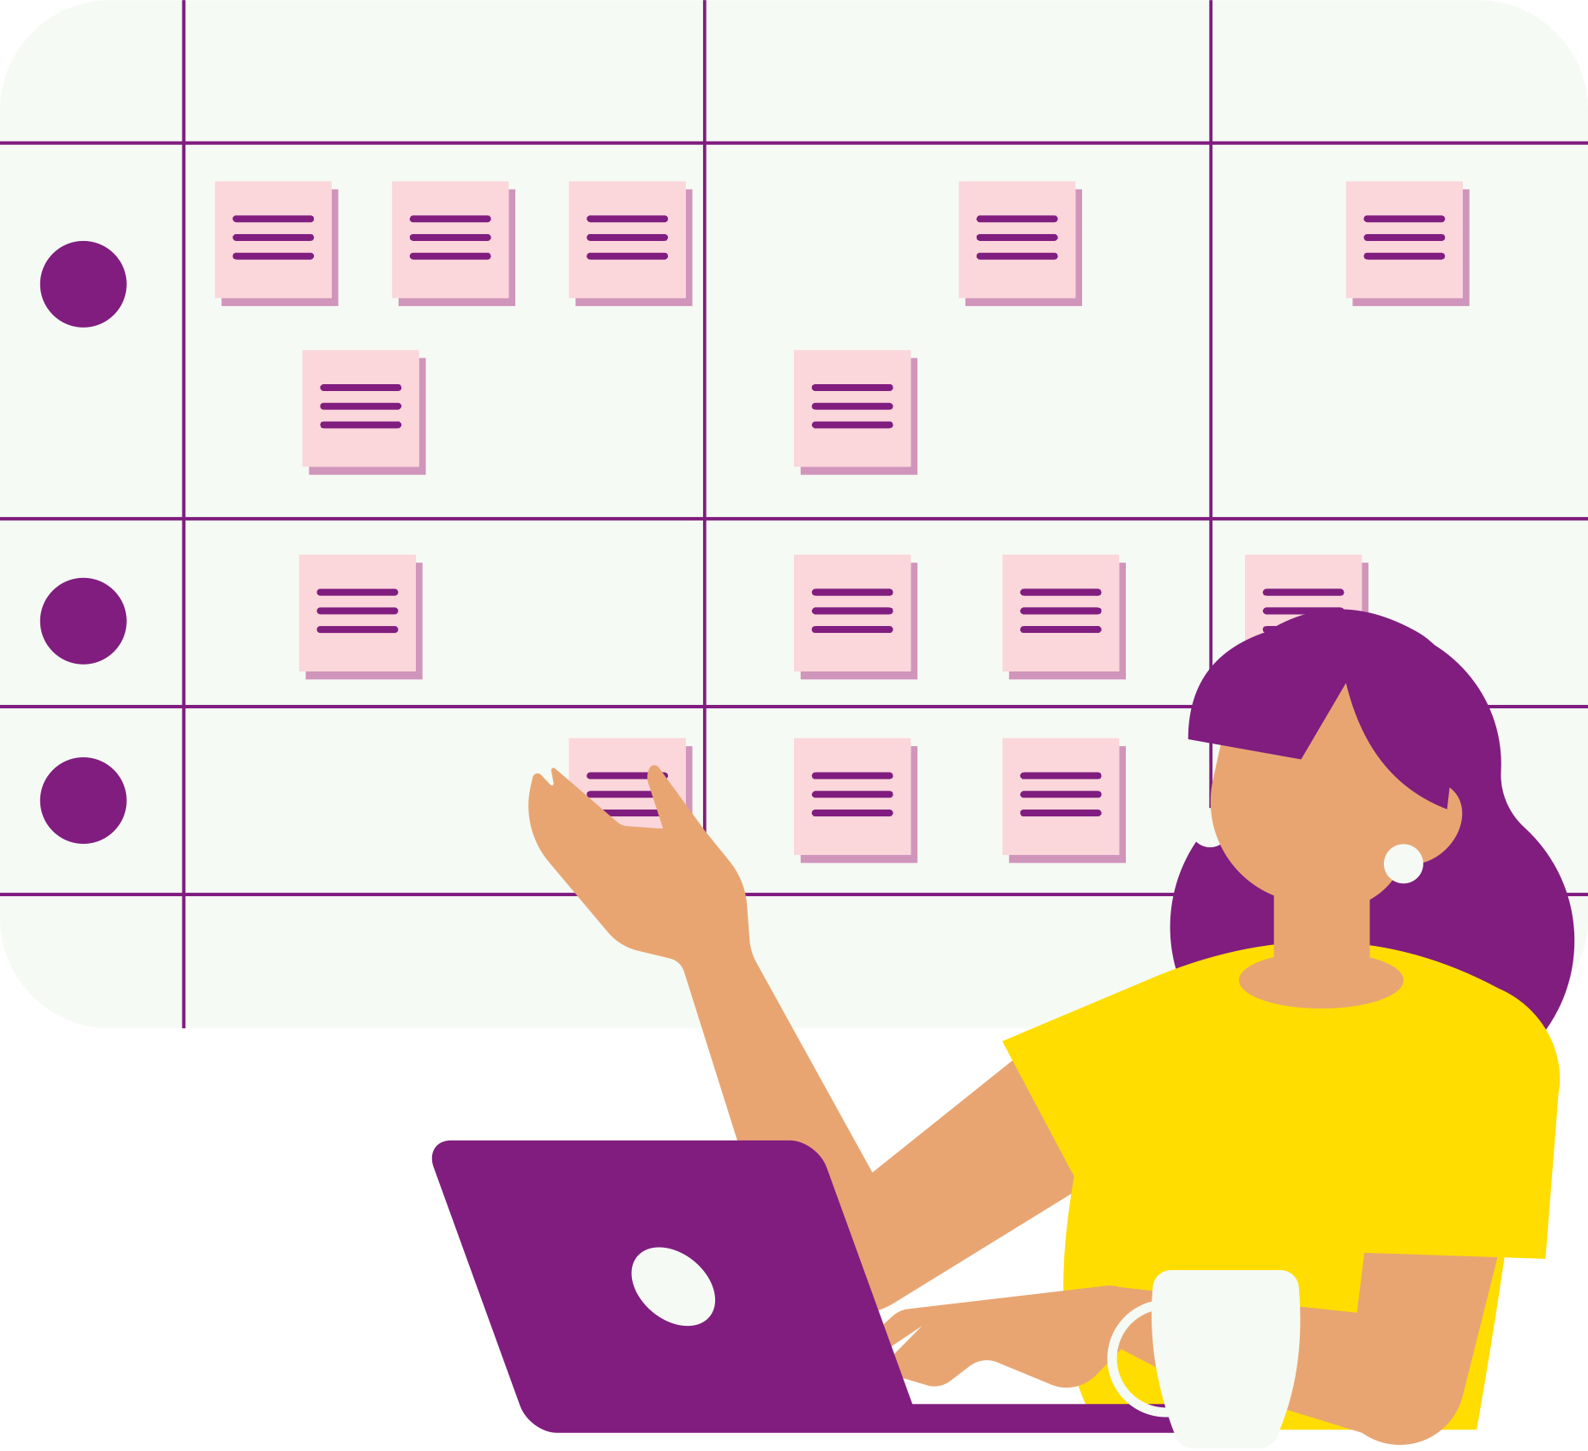
PRIMARY USER TASKS
Going past the awareness phase, main tasks that a user may do on a website are
  Try to see the services- This is an important task because it sets the tone for the consideration phase of the marketing funnel. Does Kelston have the services that the customer is needing? Are they easily able to find it? Do they understand Kelstons background or portfolio in this area?
  Try to connect on social media- This is important because perhaps the user is in the learning phase of the marketing funnel, they want more information, they can see that through social media. Going from consideration to conversion can be a process and humanizing the brand through social is important but only if they can find where to add you.
  Contacting Kelston- Going from consideration to conversion will not happen if the audience cannot contact you. Making the contact page and information is crucial to getting the conversions to happen.

Slide 4
TEST SCENERIOS
Using real users on the Kelston website, they were told to use screen recording software, only after opening the link for the first time to give feedback. I made the test scenarios below:
  DESKTOP: Find the services Kelston has to offer. Please be sure to talk through it with narration and discuss your thoughts along the way. Does it have a lot of services? Too much? Not enough? Is it organized or not? Does it need any improvements? What could be better? What is done well? Please provide thoughts Please make sure to narrate your experience. What were the hardest parts? What was easiest? What was your experience like doing this on desktop? Were there any hicccups or hard times? What would you improve if anything?
  DESKTOP: Try see Kelstons social media from the website then return back to the website. Please be sure to talk through it with narration and discuss your thoughts along the way. Is it easy to find the social media? Too difficult? ? Does it need any improvements? What could be better? What is done well? Please provide thoughts. How easy is it to return to the website? Please make sure to narrate your experience. What were the hardest parts of your user experience on this exercise? What was easiest? What was your experience like doing this on desktop? Were there any hicccups or hard times? What would you improve if anything?
  MOBILE: Try to find where to contact Kelston in two ways. Try to contact Kelston from the home page and try to see if you can find where to contact them besides the homepage. Please make sure to note your experience on which you found easier. What were the hardest parts? What was easiest? What was your experience like doing this on mobile? Were there any hicccups or hard times? What would you improve if anything?

Slide 5

TEST METHODOLGY
The tasks were completed in the following matter:
  Each user was given an invitation to become part of the testing group, one user per task
  Users were individually tested on their experience using either a recording platform such as zoom or screen recording software for the mobile test.
  Each user was told to only open the link after recording started and the process was recorded.
  Each user was either allowed to send back notes with feedback or audio of how their experience went.
  Users were able to use my laptop with zoom recording software to go through the experience if they struggled to use their own laptop for recording.
  Each experience was firsthand

Slide 6
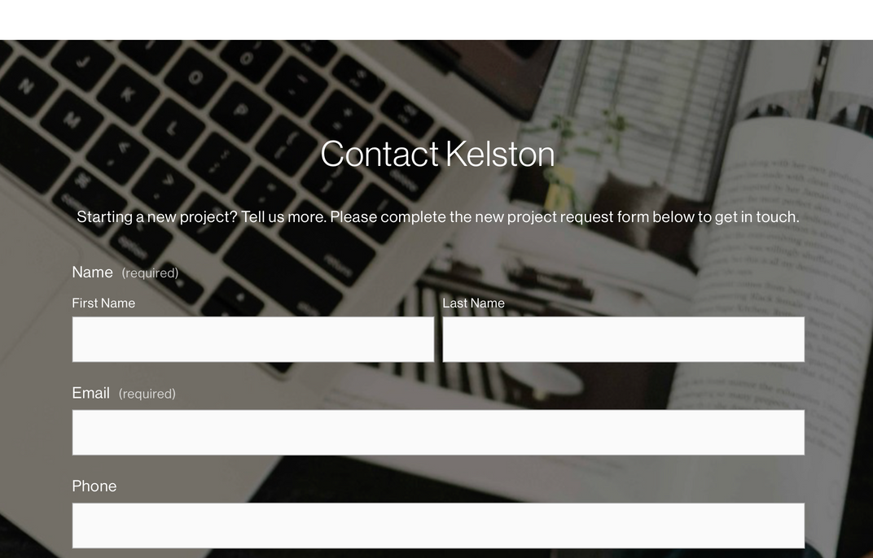
RESULTS
What worked well:
  Contact page is easy to find
  The colors were popular among the users
  East mobile usability
What did not work:
  The services were hard to find initially
  Many of the elements on the website appear clickable when they are not
  Social media is hard to find, suggestion was to move to the top toolbar
  Services would be good to have details so people can better understand them was suggested
  Many elements such as social media appear too small
  Social media icon colors blend with background color
(Kelston Marketing, n.d.)

Slide 7

TESTING VIDEOS COMPILED:
The following video contains actual users and their experience using the website for the first time.

Slide 8
RECCOMENDATIONS
  Make the navigation bar bigger
  Put social media at the top so customers can more quickly interact and engage with the brand. “Social media provides a direct channel for businesses to interact with their customers.” (Joshi, 2024)
  Made services clickable to show descriptions or examples of work
  Make sure none of the elements are blending together “Keeping things simple doesn’t mean they should blend into the background.” (Stewart, n.d.)
  Find a way to make clear what is clickable and what is not
  On the service page near the bottom there are images that show different brands and places Kelston has worked with. Some images are randomly clickable while others are not. When clicked it leads to different clients websites, not showcasing Kelsons work. This is not good as it can pull people away from the site, especially since they are not opening in a new tab. “The main value of links is that they serve as an endorsement, signaling to Google that the website being linked to is trustworthy and relevant.” (Adamnutter & Adamnutter, 2024)

Slide 9
FURTHER TESTING
  Start with implementing the given recommendations and do an A/B test to see if it is more effective.
  Test the responsiveness of the Kelston website in a minimized window rather than full screen to see responsiveness
  Test site speed
  Test data for Kelston versus that of competitors

Slide 10
Citations
  Kelston - Brand Development and Marketing Studio — Kelston | Marketing and Branding Studio in Southlake, TX. (n.d.). Kelston | Marketing and Branding Studio in Southlake, TX. https://www.kelstonmarketing.com/services
  Kelston | Branding & Design (@kelstoncreative) • Instagram photos and videos. (n.d.). https://www.instagram.com/kelstoncreative/
  Kelston: Posts | LinkedIn. (n.d.). https://www.linkedin.com/company/kelston-marketing/posts/?feedView=all
  Stewart, M. (n.d.). Important considerations for and types of navigation menus. https://www.thecreativemomentum.com/blog/5-components-on-designing-the-ideal-navigation-bar
  Joshi, V. (2024, October 9). Council Post: The Power of Social Media in Modern Marketing. Forbes. https://www.forbes.com/councils/forbesbusinesscouncil/2024/10/09/the-power-of-social-media-in-modern-marketing/
  Adamnutter, & Adamnutter. (2024, June 13). The Value of Links: Why They’re Important & How to Get Them. Retain Media. https://retainmedia.com.au/seo-insights/the-value-of-links/
  ALL IMAGES ARE STOCK IMAGES FROM CANVA

